Slide 1
Continuous integration / continuous deployment (CI/CD)

Slide 2
Objectives
After completing this lecture, you will be able to:
Describe Continuous Integration and Continuous Deployment (CI/CD)
Describe the Continuous Integration and Continuous Deployment capabilities in IBM Cloud Private (ICP)
Describe the build automation technologies in IBM Cloud Private
Describe the best practices for automating enterprise ICP deployments

Slide 3
Agenda
CI/CD pipeline in ICP
Build tools (build/ship/run)
Deployment Environments (build/ship/run)

Slide 4



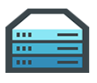













Docker Mission
Docker is an open platform for building distributed applications for developers and system administrators – Build/Ship/Run
Build
Ship
Run
Any App
Anywhere

Slide 5
Definitions
CI is Continuous Integration (Build/Ship)
Builds, unit tests, integration tests, performance tests, …
CD is Continuous Deployment (Run)
Deploying and maintaining pre production and production environment
CI is Dev, CD is Ops, so CI&D is DevOps (Build/Ship/Run)

Slide 6

Jenkins
Popular open-source framework for Continuous Integration
Monitors execution of repeated jobs; examples: cron jobs or builds
Generally used for:
Building/testing software projects continuously
Monitoring executions of externally-run jobs, such as cron jobs

Slide 7

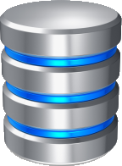
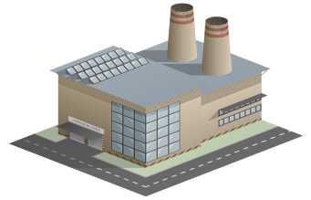


ICP Continuous Integration (Build/Ship/Run)
Frequently performing all of these steps in sequence:
Development
Rapidly implementing changes in small, tested batches
Source Code Management
Merging changes from multiple developers
Build
Creating new deployment artifacts
Package
Installing builds into runtimes
Releasing runtimes as immutable images
Development
SCM
Build
Package Repo
Continuous Integration
Squad/Team Level Automation
ICP

Slide 8
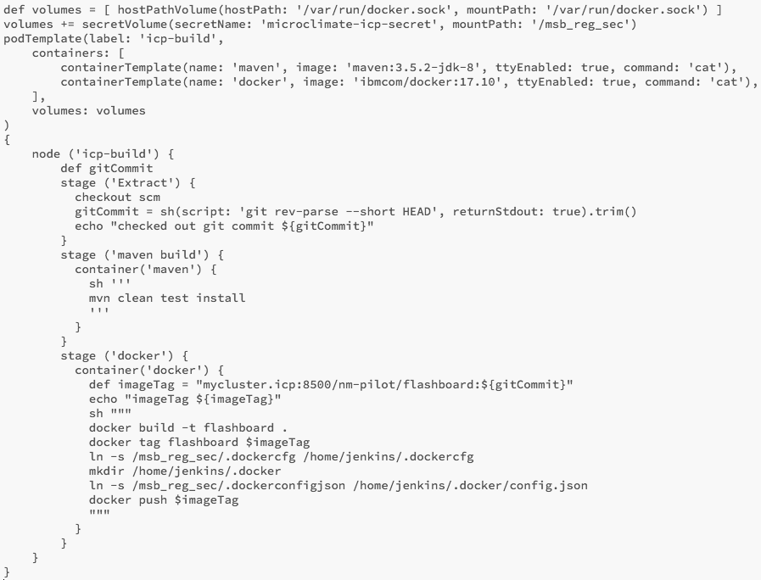
Automating build
Jenkinsfile: Script file that is used to describe a Jenkins Pipeline. The file can be stored in a source control system and is loaded whenever the pipeline is triggered.
podTemplate: Describes the docker containers that will be used by this Jenkinsfile and attaches the required docker secrets
maven stage: Executes a maven clean, test and install build process
Extract stage: Extracts the source code from git and gets the last commit id
docker stage: Builds the flashboard docker image, tags it with the commit id and pushes it to IBM Cloud Private

Slide 9
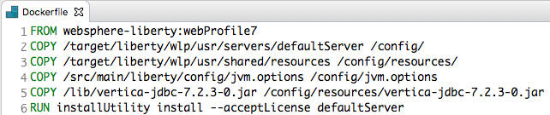
Dockerfile for Liberty
FROM: Base image for the new image. IBM has published an official set of foundational Docker images containing IBM products, such as WebSphere Liberty
Dockerfile: A text file containing Docker image building instructions
COPY: Instruction to copy a configured Liberty server with your application deployed as a whole
COPY: Instructions to copy shared resources and jvm.options files to the correct folders in the image
RUN: Execute shell commands to install all required Liberty features
COPY: Instead of copying a configured Liberty server, you may also copy a configured server.xml file and application deployable to the image
Alternate

Slide 10
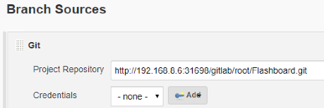
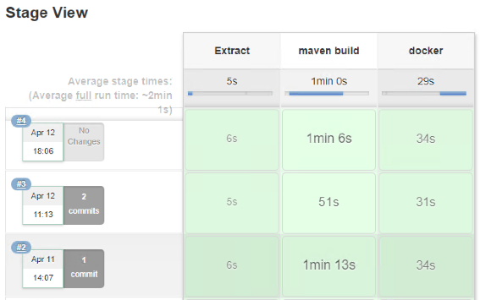
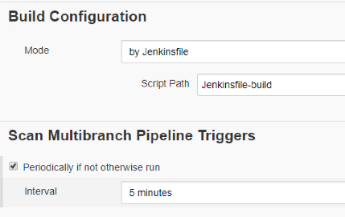
Jenkins Pipeline for automated build
Branch Sources: used to configure the Git Project Repository
Build Results: displays the most recent pipeline executions and the results by stage
Build Configuration: used to specify the name of the Jenkinsfile and how often to scan the Project Repository for changes (5 minutes)

Slide 11





ICP Continuous Deployment (Build/Ship/Run)
Release Train
Rapidly progressing the latest packaged build through the test lifecycle stages and into production
Deploy to Test
Perform functional testing
Deploy to Stage
Rehearse production deployment
Perform integration testing
Deploy to Prod
Make the build available to users
Configure:
Applications
Middleware
Databases
APIs
Package Repo
Deploy
Test
Stage
Prod
ICP
Rules for promotion
Release
Automated Test Deployments

Slide 12
ICP CI/CD (Continuous Delivery) pipeline
Release Train
Configure:
Applications
Middleware
Databases
APIs
Development
SCM
Build
Package Repo
Deploy
Test
Stage
Prod
ICP
Continuous Integration
Rules for promotion
Squad/Team Level Automation
Release
Development/Test/Production parity
Automated Test Deployments

Slide 13
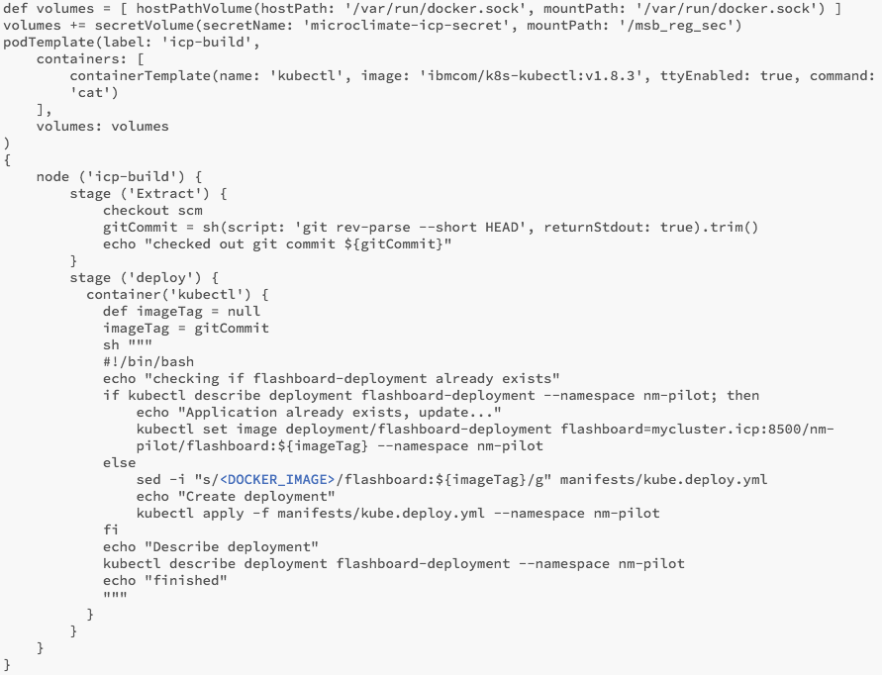
Automating deployment using Jenkins
podTemplate: Deployment requires a docker container with the kubernetes CLI installed
Extract stage: Extracts the source code from git and gets the last commit id
deploy stage: uses the Kubernetes CLI to check whether the deployment already exists.
If the deployment exists then it is updated with a new docker image which triggers the Pods to be destroyed and recreated with the new image.
If the deployment doesn’t exist then the deployment script file is updated with the docker image name and tag and then the deployment and service are created

Slide 14
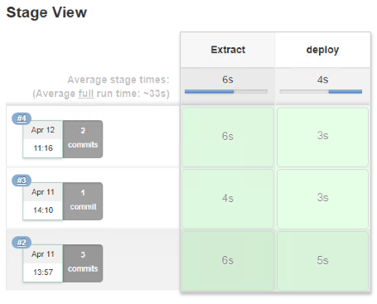
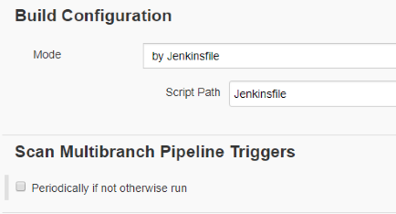
Jenkins Pipeline for automated deploy
Branch Sources: used to configure the Git Project Repository
Build Results: displays the most recent pipeline executions and the results by stage.
Build Configuration: used to specify the name of the Jenkinsfile and how often to scan the Project Repository for changes (in this case never as this pipeline is manually triggered)

Slide 15
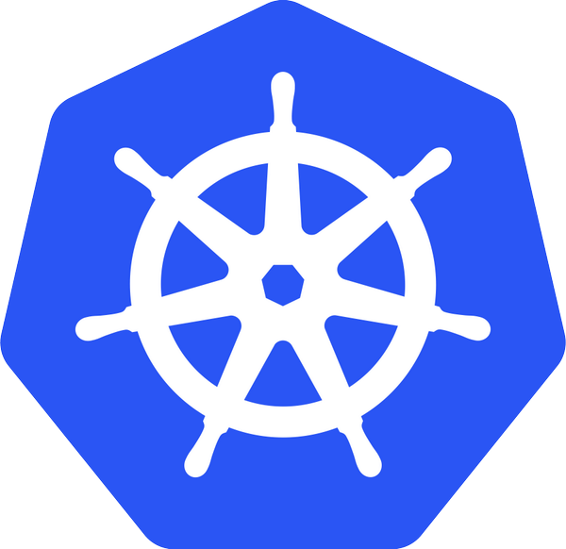

Automation
Helm
A package manager for Kubernetes
Enables multiple Kubernetes resources to be created with a single command
Deploying an application often involves creating and configuring multiple resources

Slide 16




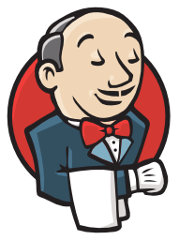
Helm Deployment
ICP
Dev
ICP
QA
Test
StagingQA
Code config change
Build
Deploy Helm Chart
ICP
Prod
Production Deployment
Dev
Registries
Registries
Registries
Registries
Registries
Triggers Helm
Triggers unit test
Triggers system test
Single build process
Environment file to deploy to different environments
Scripts, etc. treated as code and stored in Git
Triggers build

Slide 17
Quality gates and trusted, secure image repo
ICP
Dev
ICP
QA
Test
StagingQA
Code config change
Build
Deploy Helm Chart
ICP
Prod
Production Deployment
Dev
Registries
Registries
Registries
Registries
Registries
Triggers Helm
Triggers unit test
Triggers system test
Triggers build

Slide 18
Deployment to Hybrid
ICP
Prod
Production Deployment
ICP
Dev
ICP
QA
Test
StagingQA
Code config change
Build
Deploy Helm Chart
Other Environment
Prod
Production Deployment
Production releases of hybrid applications / services across enterprise
Dev
Registries
Registries
Registries
Registries
Registries
Triggers Helm
Other Environment
Prod
Production Deployment
Triggers unit test
Triggers system test
Triggers build
Triggers deployment

